Slide 1


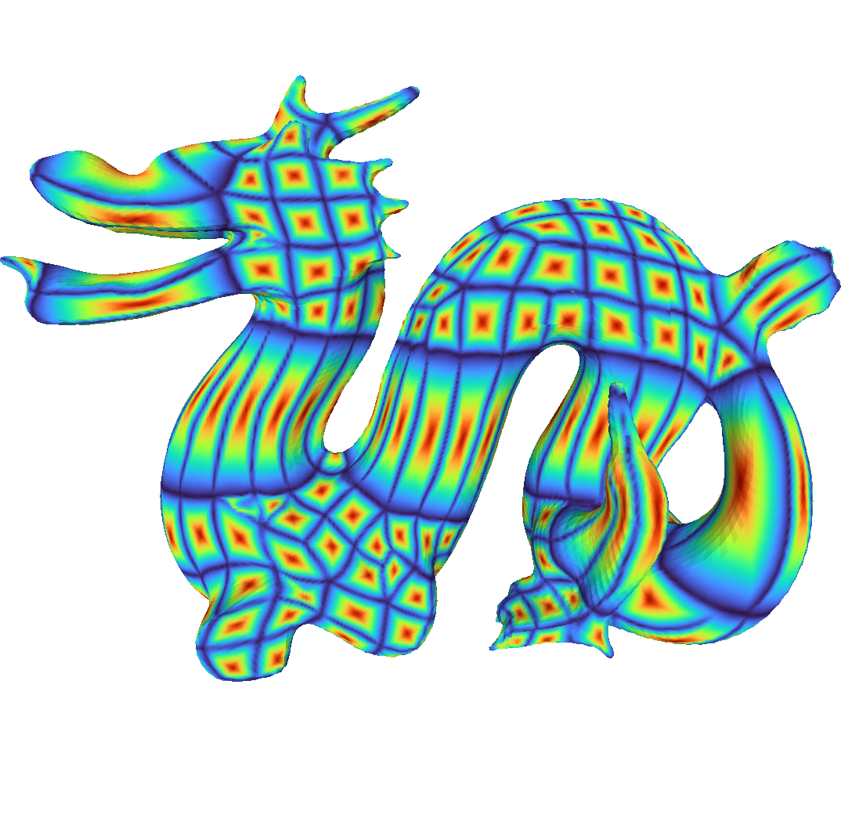
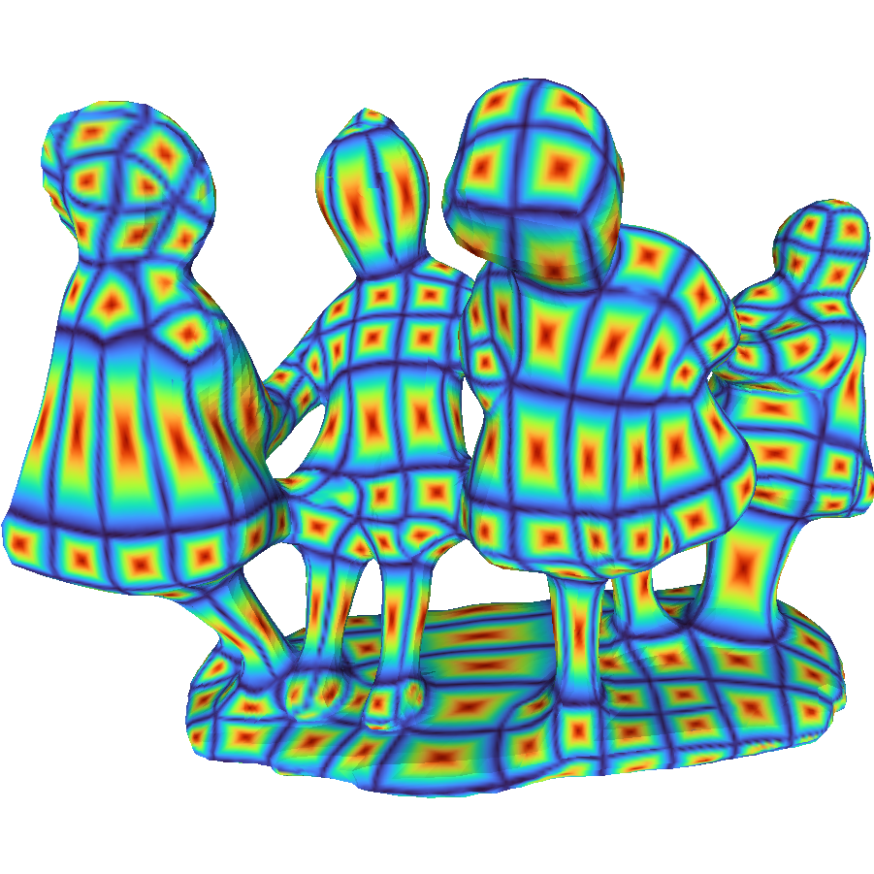
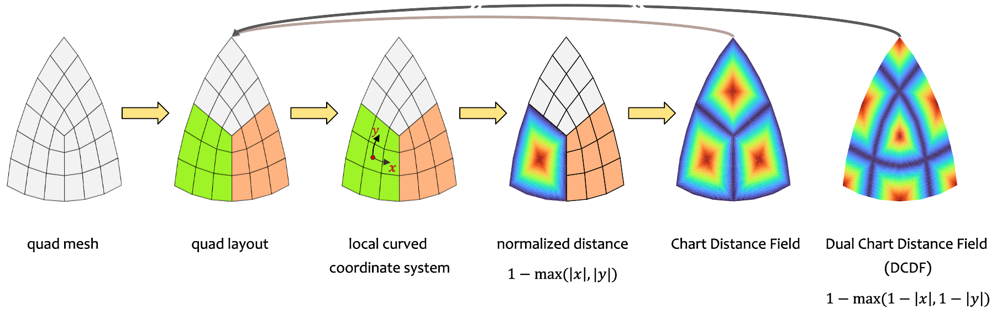
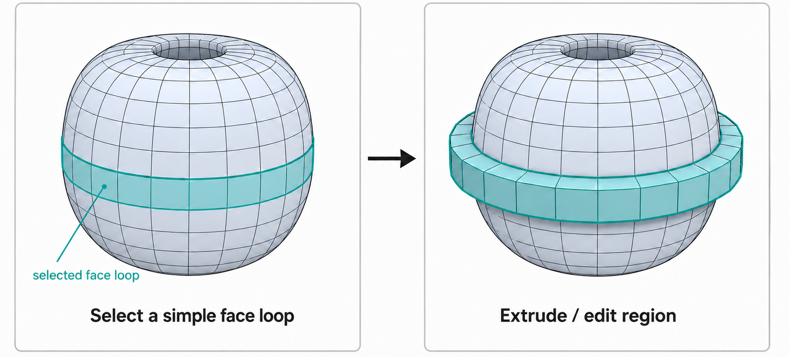
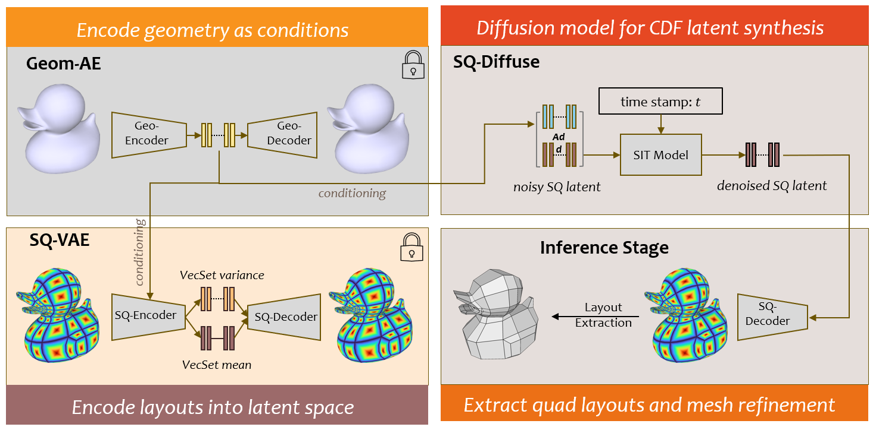
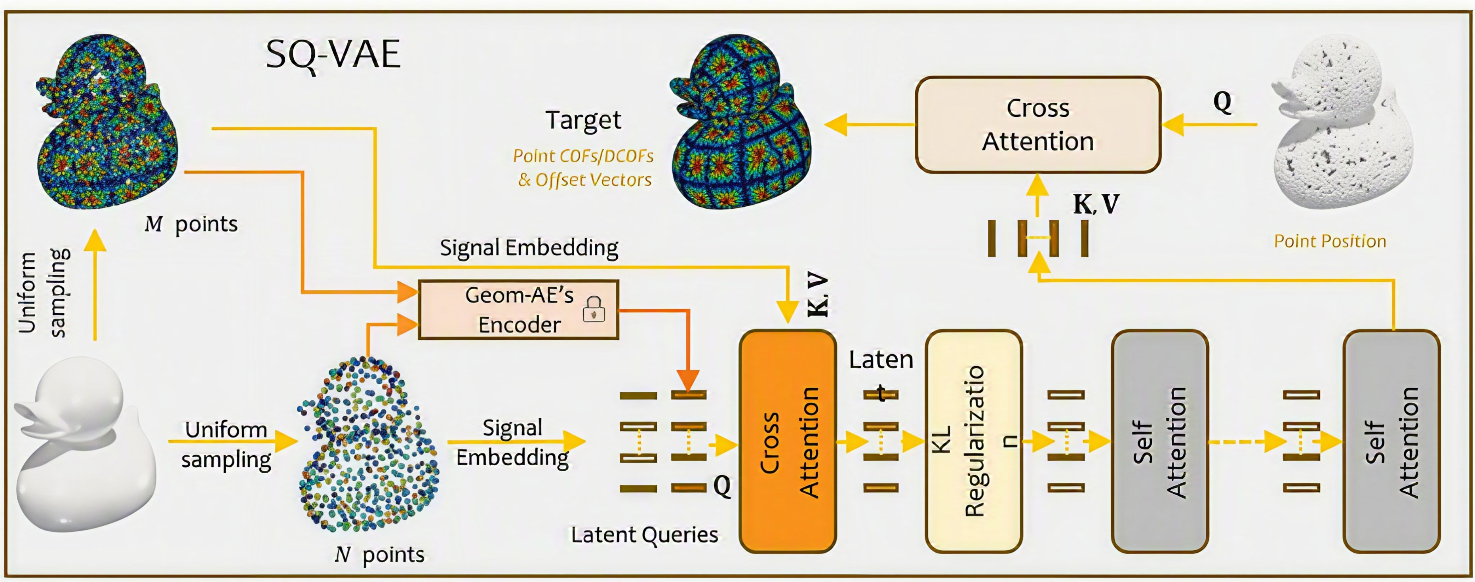
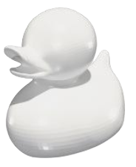
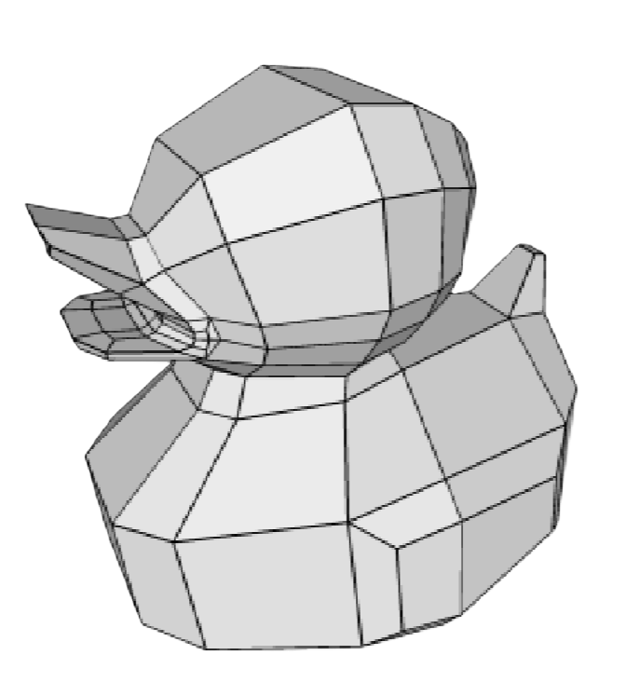
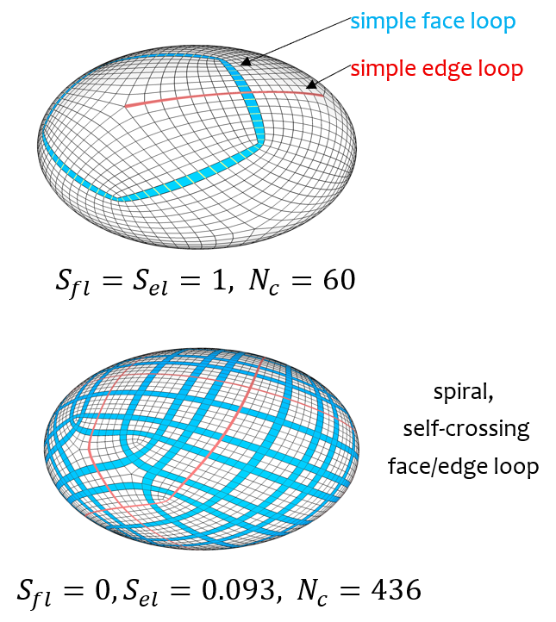
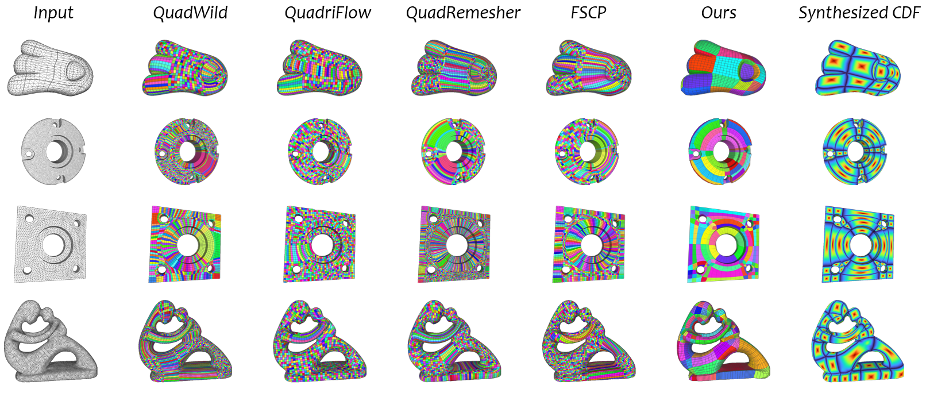
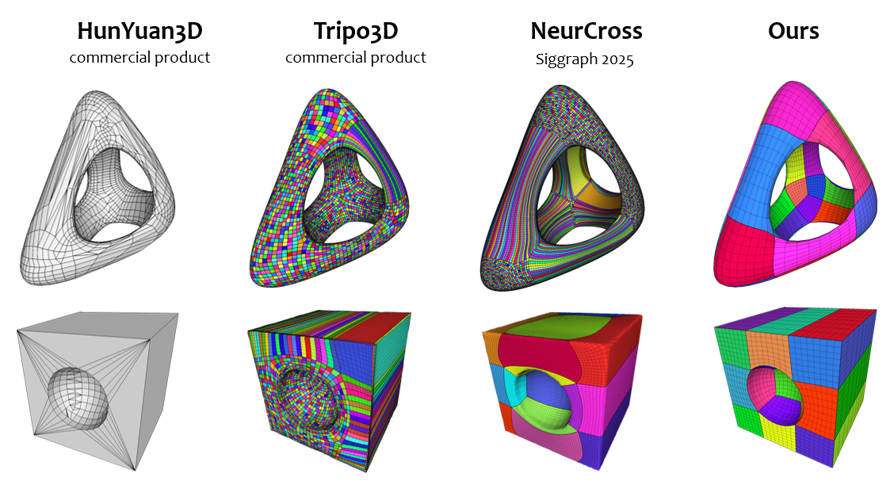
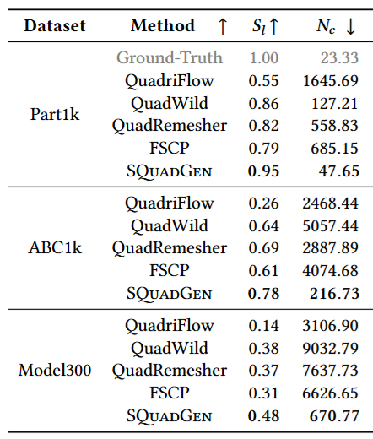
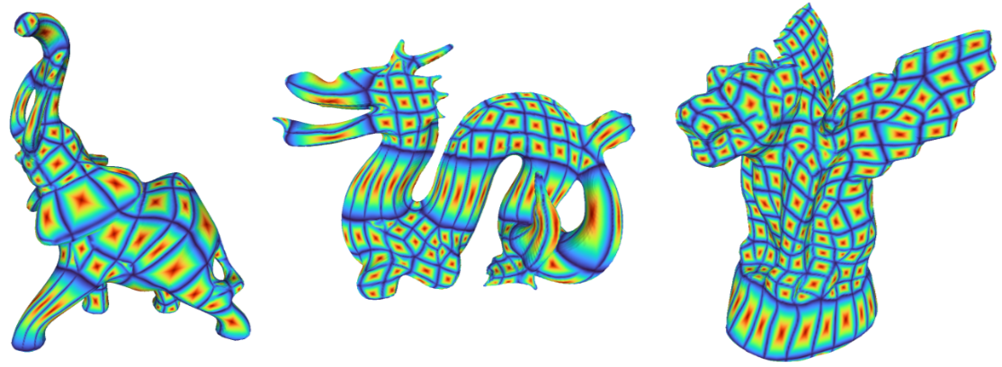
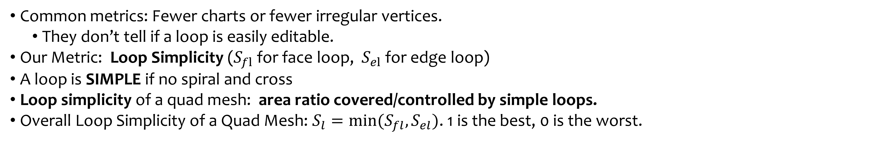
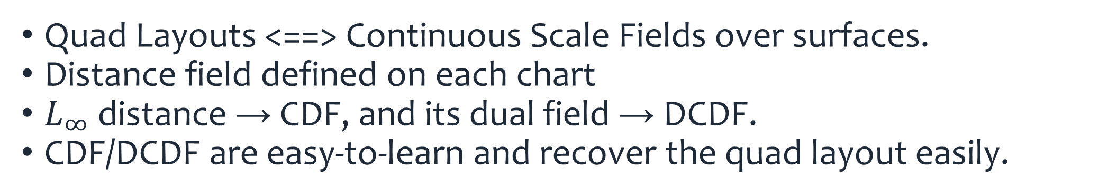
SQuadGen: Generating Simple Quad Layouts via Chart Distance Fields
You-Kang Kong¹² · Yang Liu² · Yue Dong² · Xin Tong² · Heung-Yeung Shum²³
¹Tsinghua University · ²Microsoft Research Asia · ³IDEA
Contributions
Representation: Chart Distance Fields
Representation: Chart Distance Field — easy-to-learn continuous fields for quad layout generation​
Loop Simplicity: Loop-editing-aware metric​
Dataset — 230k simple quad layouts: diverse, large-scale, high loop simplicity scores.​
SQuadGen: Diffusion model to generate CDFs and yield simple quad layouts.​
Quad Layouts <==> Continuous Scale Fields over surfaces.​
Distance field defined on each chart
$L_{∞}$ distance → CDF, and its dual field → DCDF.
CDF/DCDF are easy-to-learn and recover the quad layout easily.
Chart Distance Fields
Dual Chart Distance Fields
Motivation
Framework: SQuadGen
What kind of Mesh Layouts are preferred by 3D artists? How do they model and edit meshes?
  Easily Editable Quad Layout.
  They rarely move one vertex at a time; instead, they edit with loops — edge loops, face loops. edge rings.​
The loop-based editing works best when
  the layout is “simple”: 1. loops without spiral/self-crossing. 2. quad(-dominant) mesh layouts.
Questions: (1) How to measure loop-aware editability? (2) How to generate the “simple” quad layout?
Goal: given 3D surface, generate simple quad layout
Editability Metric: Loop Simplicity
Evaluation
Common metrics: Fewer charts or fewer irregular vertices.
  They don’t tell if a loop is easily editable.
Our Metric: Loop Simplicity ($S_{fl}$ for face loop, $S_{el}$ for edge loop)
A loop is SIMPLE if no spiral and cross
Loop simplicity of a quad mesh: area ratio covered/controlled by simple loops.
Overall Loop Simplicity of a Quad Mesh: $S_{l}=\min{(S_{fl},S_{el})}$. 1 is the best, 0 is the worst.
in-domain
Our Key Insights
out-of-domain
simple layouts with feature preserving
Learning perspective: Learn from artist-created quad layouts to match artists’ preference​
Representation Perspective​: Treat layout generation as continuous field synthesis, NOT next token(vertex/face) prediction !
​Generative Perspective​: Diffusion models excel at smooth signals, generate the field first, then read the quad layout out of it.​
stress test
well generalization ability

