Slide 1
SQuadGen
Generating Simple Quad Layouts via Chart Distance Fields
Chart Distance Field (CDF) Visualization
You-Kang Kong¹² · Yang Liu² · Yue Dong² · Xin Tong² · Heung-Yeung Shum²³
¹Tsinghua University · ²Microsoft Research Asia · ³IDEA
Notes:
Hello everyone, my name is You-Kang Kong, a PhD student from Tsinghua University, and this work was done together with my mentors at Microsoft Research Asia.
Today I will introduce SQuadGen — Generating Simple Quad Layouts via Chart Distance Fields, which is a new representation.

Slide 2
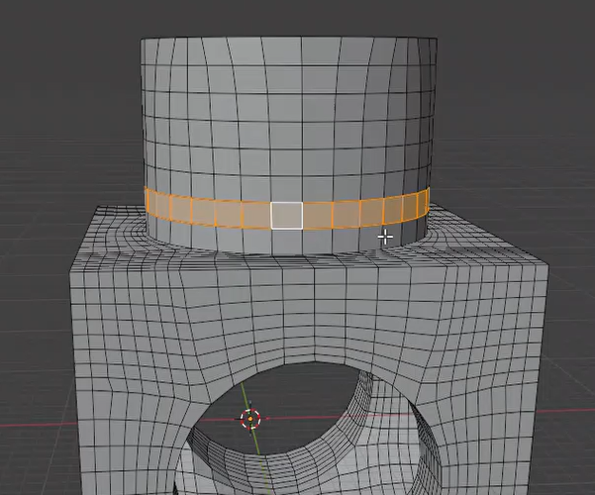
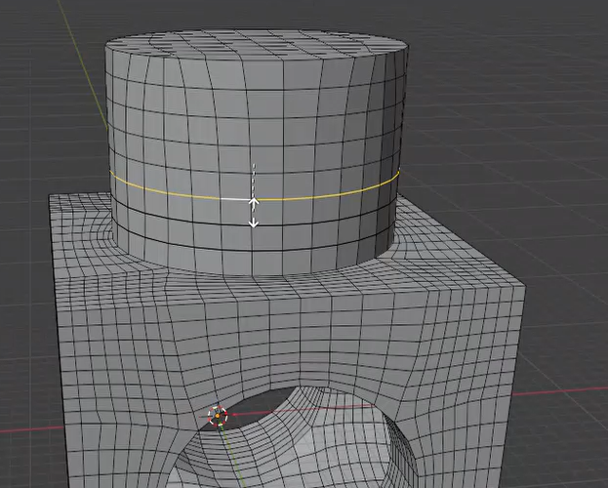
What Artists Want: Easily Editable Layouts
“Artist-like” mesh → vague
Real Goal: Editability
How 3D artists work?
  Select & Edit with loop tools: vertex loops · edge loops · face loops · edge rings
  Loop tools work conveniently when the layout is Simple
  Intuitive meaning of Simple:
    A clean loop goes around once — no spiral, no self-crossing
    Underlying mesh — full-quadrilateral / quad-dominant meshes
  Messy layout: loops break down, editing become painful
Face loop
edge loop
edge ring
Notes:
[click] Let me start with a phrase you often hear: “artist-like” meshes — but nobody agrees on what that means.
[click] So let's make it concrete. We believe the real goal comes down to one word: editability.
[click] Think about how an artist actually works. They rarely move one vertex or edge; instead, they edit with loops — edge loops, face loops, and edge rings.
They pick a loop and slide or scale it, so a single action changes a whole loop.
[click] But there is a condition: loop tools only work when the layout is simple. The simple loops never spiral and never cross itself.
When the layout is messy, the loops break down, and editing becomes painful.

Slide 3
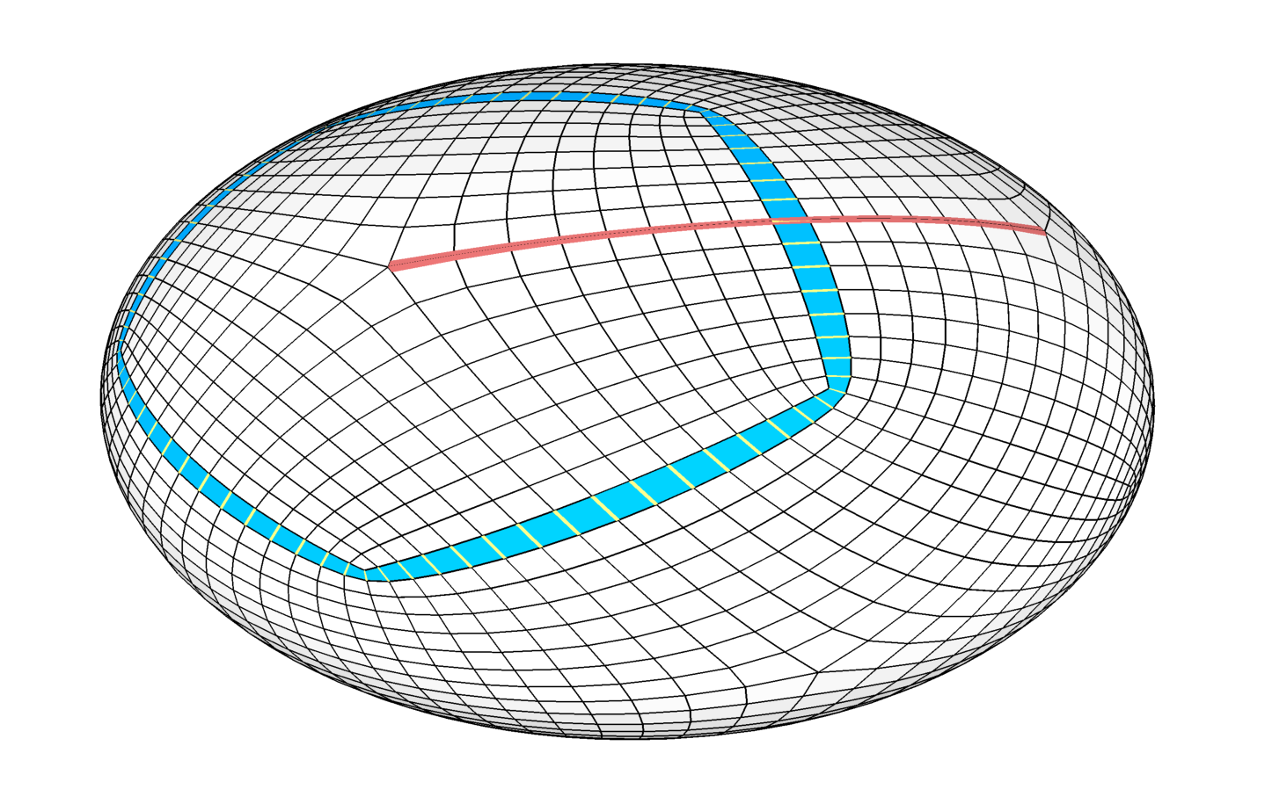
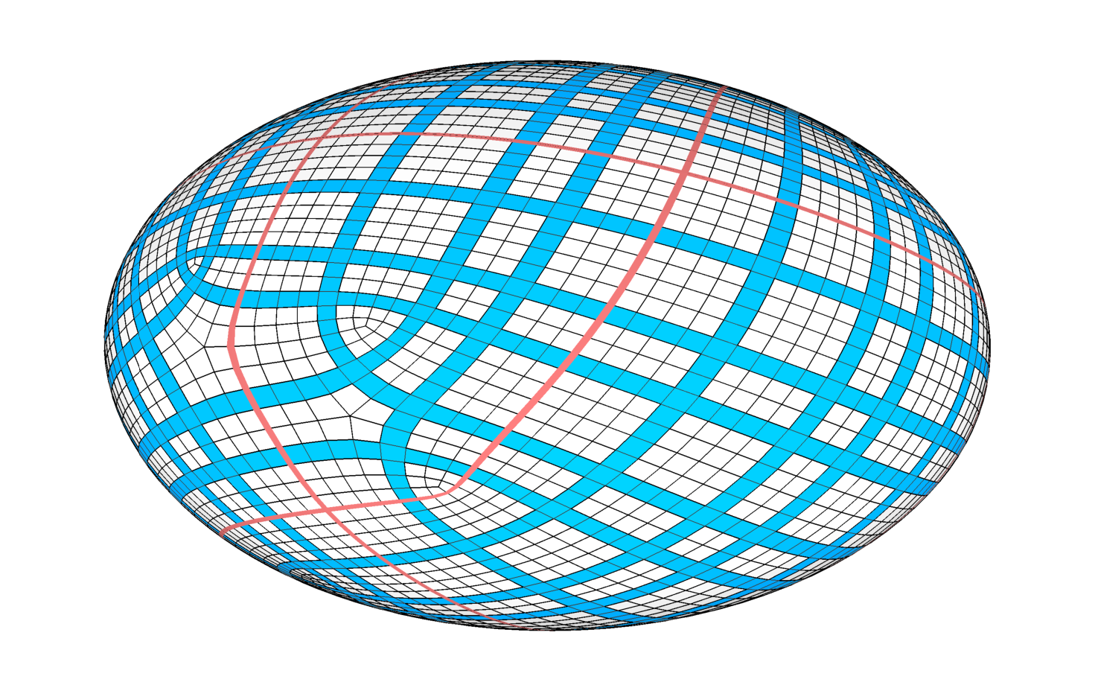

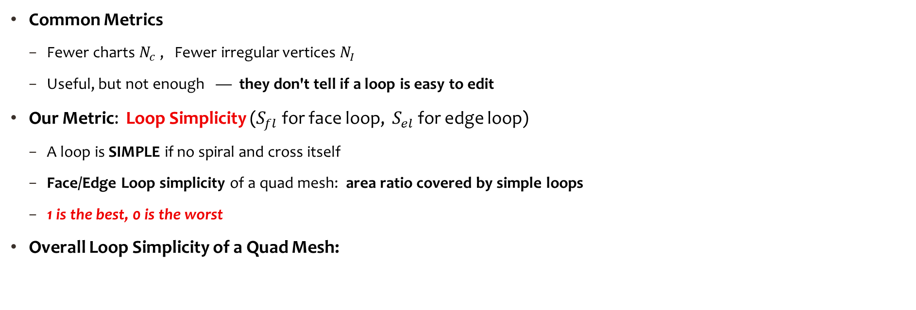


Loop Simplicity of Quad Layouts
simple face loop
simple edge loop
Common Metrics
  Fewer charts $N_{c}$ , Fewer irregular vertices $N_{I}$
  Useful, but not enough — they don't tell if a loop is easy to edit
Our Metric: Loop Simplicity ($S_{fl}$for face loop, $S_{el}$ for edge loop)
  A loop is SIMPLE if no spiral and cross itself
  Face/Edge Loop simplicity of a quad mesh: area ratio covered by simple loops
  1 is the best, 0 is the worst
Overall Loop Simplicity of a Quad Mesh:
$S_{fl}=S_{el}=1,$ $N_{c}=60$
spiral,
self-crossing face/edge loop
$$S_{l}=\min{(S_{fl},S_{el})}$$
$S_{fl}=0, S_{el}=0.093,$ $N_{c}=436$
Notes:
Since artist prefers a simple quad layout — so we need a metric to measure how simple a layout really is.
[click] The common answer is to count charts and irregular vertices, fewer is better. That helps, but it doesn’t tell us whether the loops are actually easy to edit.
[click] So we propose a new metric, Loop Simplicity. For each loop, we define it is simple if no spiral and cross itself.
[click] [click]
The face or edge loop simplicity is the area covered by simple loops — one is best, zero is worst.
[click] We take the minimum of the face and edge-loop simplicity as the overall loop simplicity.

Slide 4
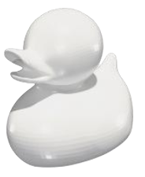
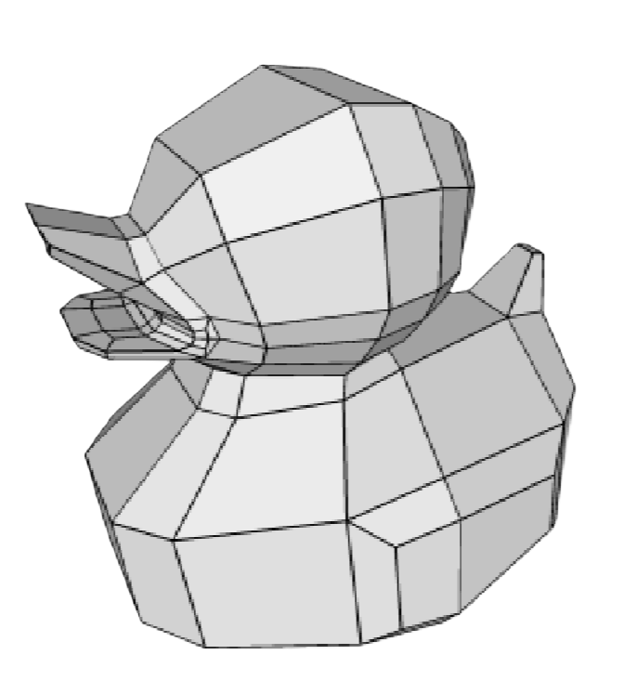
Our Goal: Simple Quad Layout Generation
Given a 3D surface, generate a quad mesh
with simple, easily-editable layout !
Notes:
So our goal is, given a 3D shape, generate a quad mesh with simple, easily-editable layout.

Slide 5
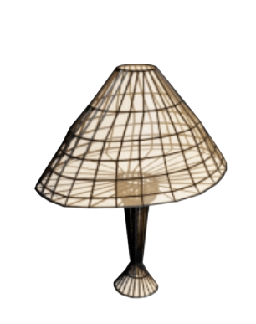
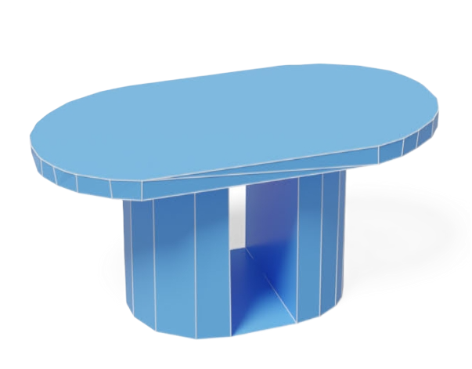
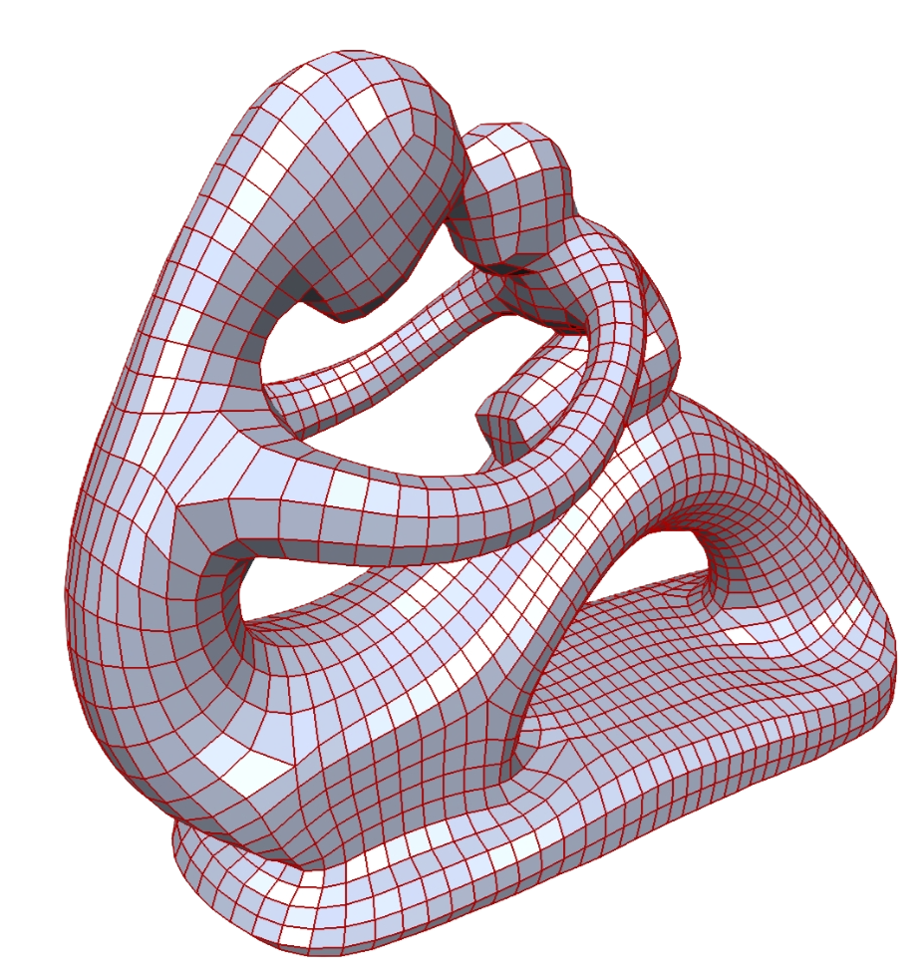
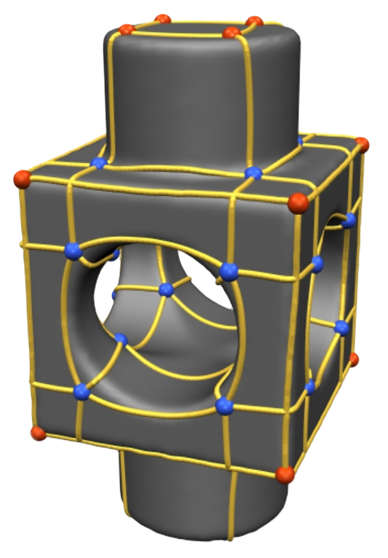
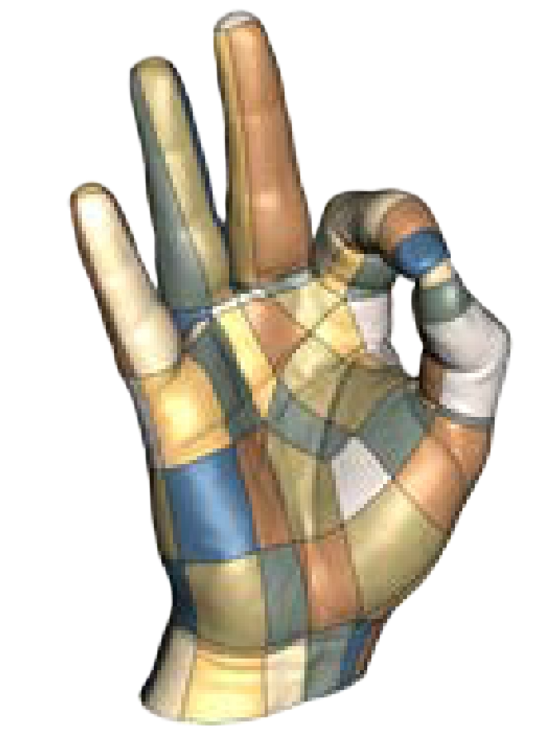
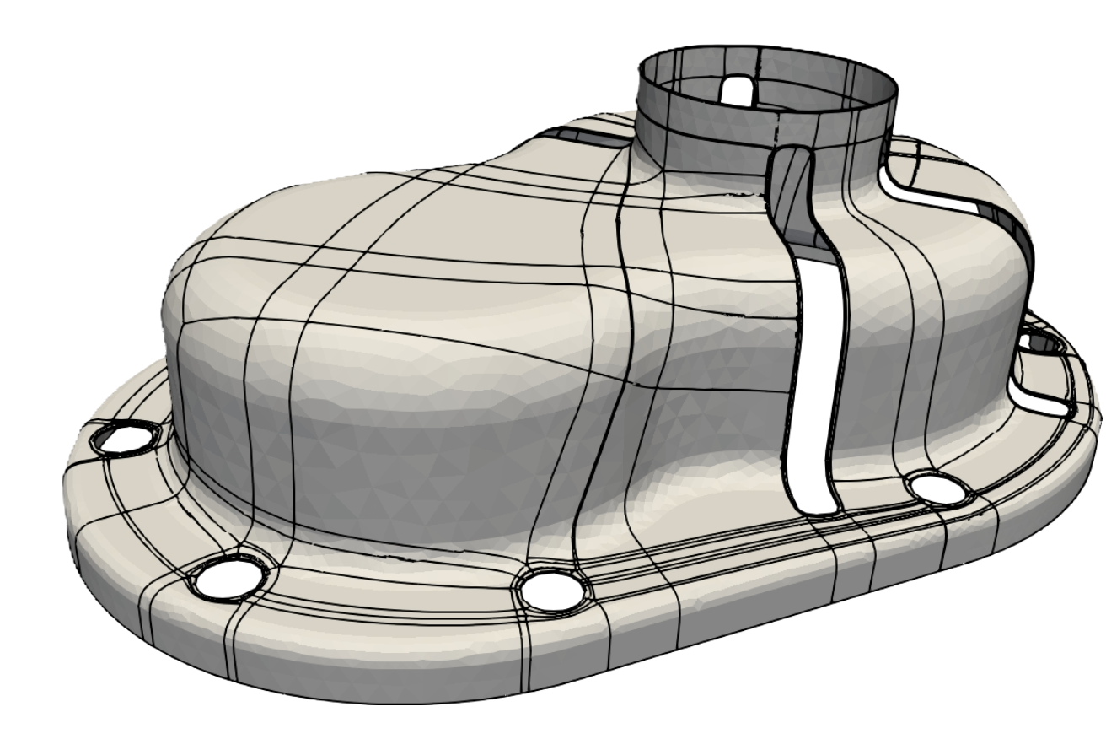
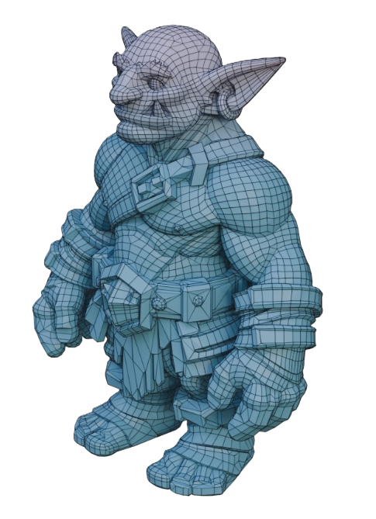
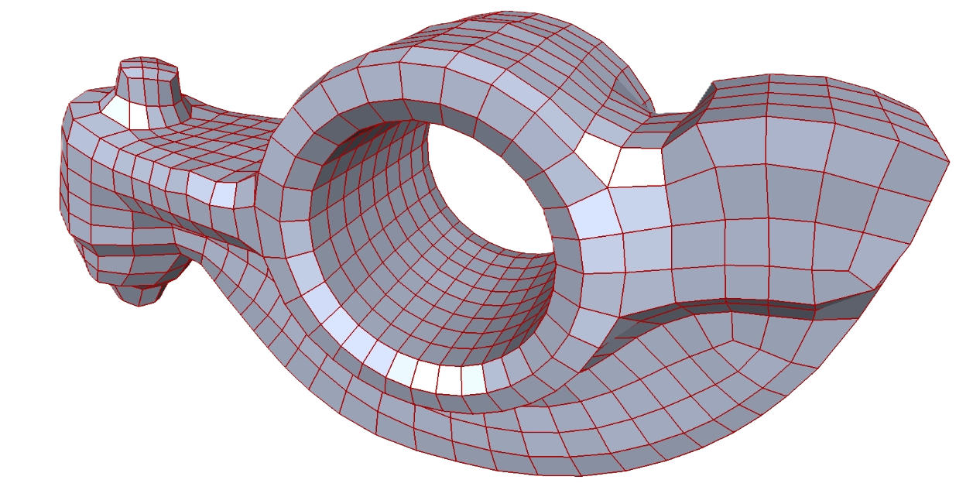
Related Work – Quad Layout
Quad Remeshing
Directional/cross/frame fields [Kalberer et al. 2007, Bommes et al. 2013, Campen et al. 2015, etc.]
Focus: field smoothness, field integrability, feature preservation
Layout simplification
Dual Loop [Campen et al. 2012], Graph Optimization [Tarini et al. 2011, Bommes et al. 2011, Couplet et al. 2021, etc.]
Focus: reduce irregularities
Generative meshing
PolyGen [Nash et al. 2020], MeshGPT [Siddiqui et al. 2024], SpaceMesh [Shen et al. 2024], QuadGPT [Liu et al. 2026], etc.
Methodology: Directly predict discrete mesh topology Sequentially, not holistic
It is hard for integer optimization to ensure global simplicity
It depends on good starting layout.
It doesn’t aware simplicity, hard to stay manifold.
Notes:
Let me introduce the related works; I’ll group into three lines.
[click] The first is quad remeshing, it relies on cross fields and integer programming. It produce all-quad meshes, but it is hard for integer optimization to ensure the global simplicity.
[click] The second is layout simplification, it optimizes where the singular points go, but it depends on a good starting layout.
[click] The third is generative models, it generates the face or vertex one by one. It’s exciting, but it doesn’t aware the simplicity, and hard to stay manifold.
Our work takes a different path from all three.

Slide 6
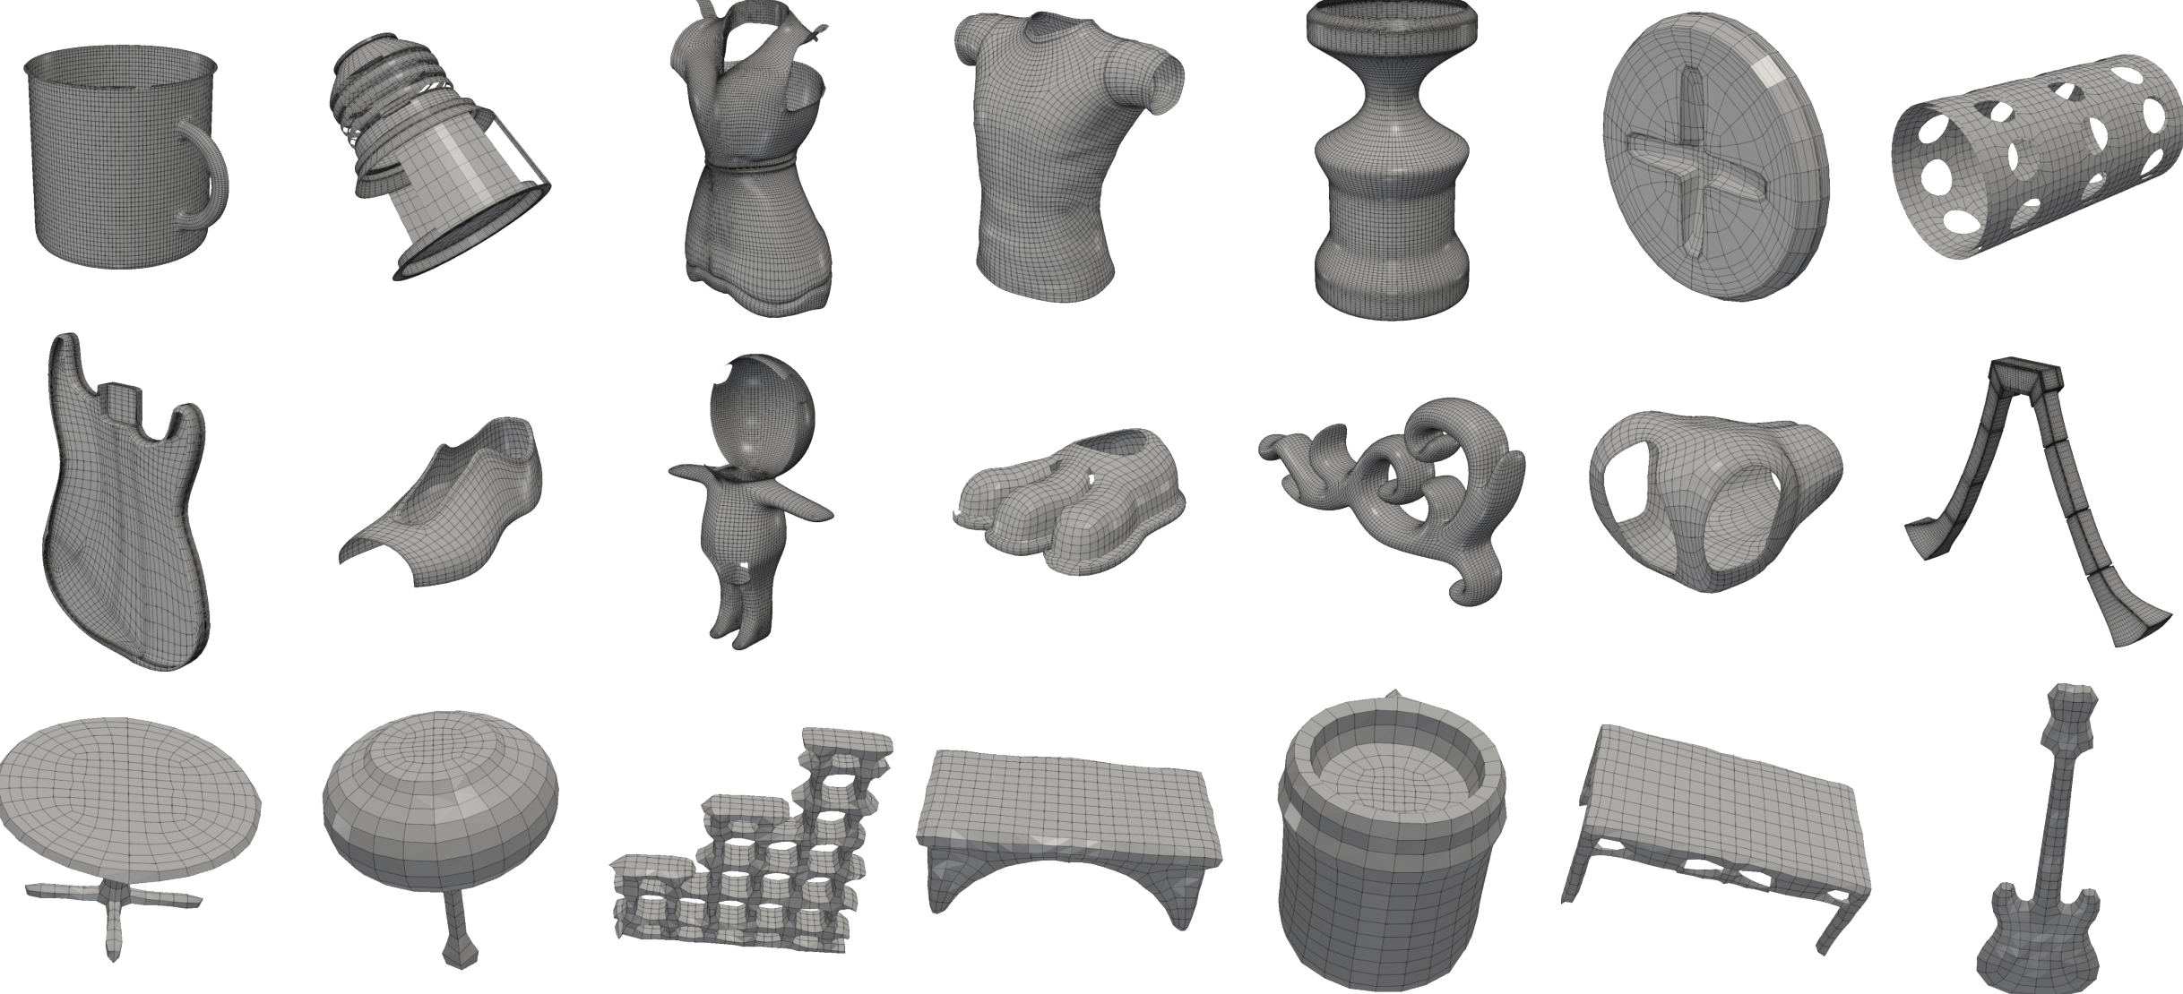
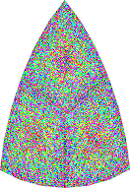
Our Key Idea
denoise
Learning perspective
Representation Perspective
Generative Perspective
Learn from artist-created quad layouts to match artists’ preference
Treat layout generation as continuous field synthesis, NOT next token (vertex/face) prediction.
Diffusion models excel at smooth signals: generate the field first, then read the quad layout out of it.
Notes:
Our approach depends on three ideas.
[click] First, a learning perspective: simple layouts are closely tied to how artists model, so we learn directly from artist-created layouts.
[click] Second, a representation perspective: instead of predicting mesh topology token by token — we treat layout generation as generating a continuous field.
[click] Third, a generative perspective: diffusion models excel at smooth signals, so we generate the field first and then read the quad layout out of it.

Slide 7



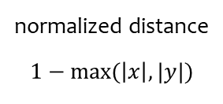
Representation: Chart Distance Fields (CDF)
Chart Distance Field: Representing Quad Layouts as Continuous Scale Fields over Surfaces.
$$y$$
$$x$$
quad mesh
quad layout
local curved
coordinate system
normalized distance
$$1−max⁡(\left|x\right|,|y|)$$
Chart Distance Field(CDF)
Dual Chart Distance Field
(DCDF)
$$1−max⁡(1−\left|x\right|,1−\left|y\right|)$$
Please refer to the paper for details.
Notes:
This brings us to our representation, the Chart Distance Field, or CDF.
[click] Take a quad mesh: we decompose it into charts.
[click] Each chart is isomorphic to a grid, so we can define a local coordinate system, with the x and y axes following the edge flow.
[click] Inside each chart we define an L-infinity distance, [click] then normalize and invert it to obtain a smooth distance field.
[click] And then we obtain the Chart Distance Field, CDF.
[click] We also build a Dual Chart Distance Field, DCDF, in the same way.
[click] From either the CDF or the DCDF, we can recover the quad layout easily.
That is the core idea.

Slide 8
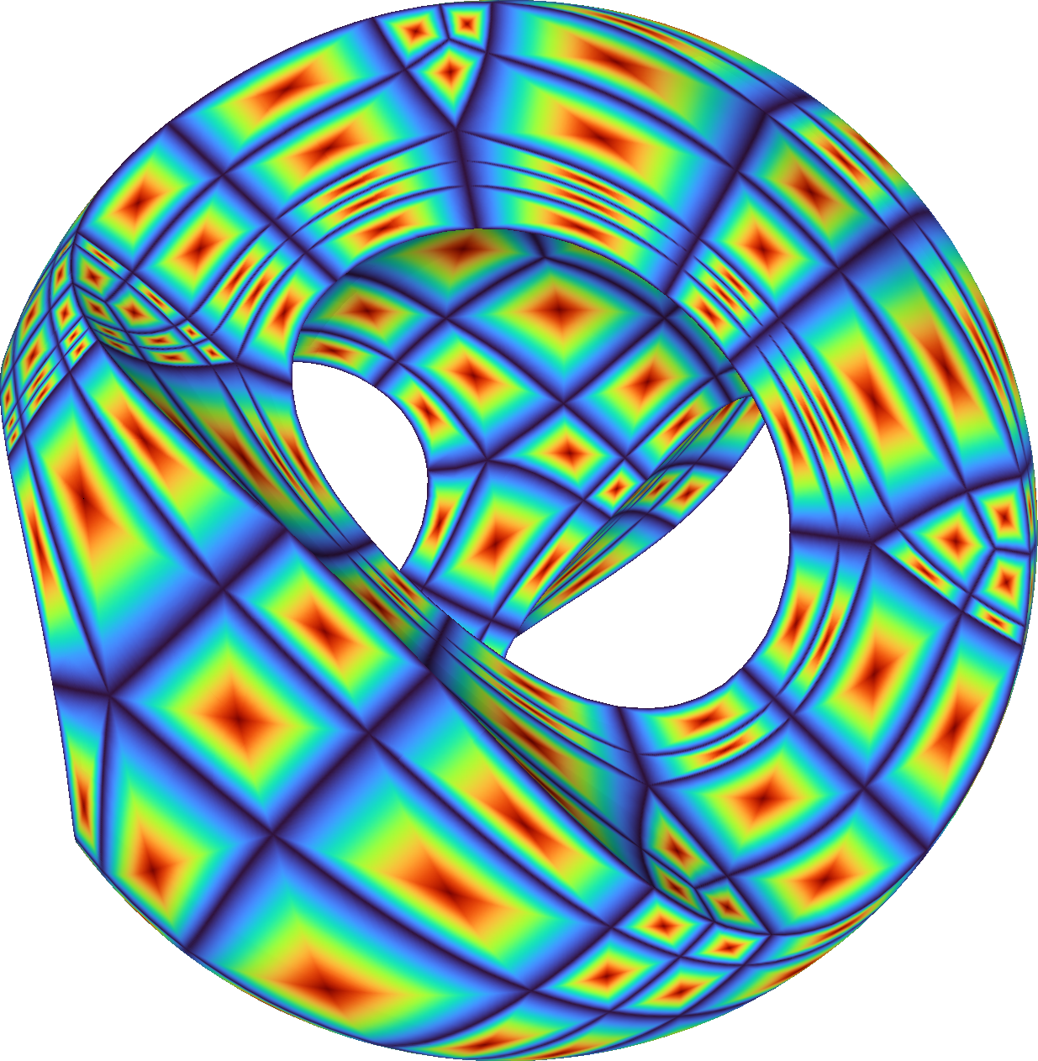
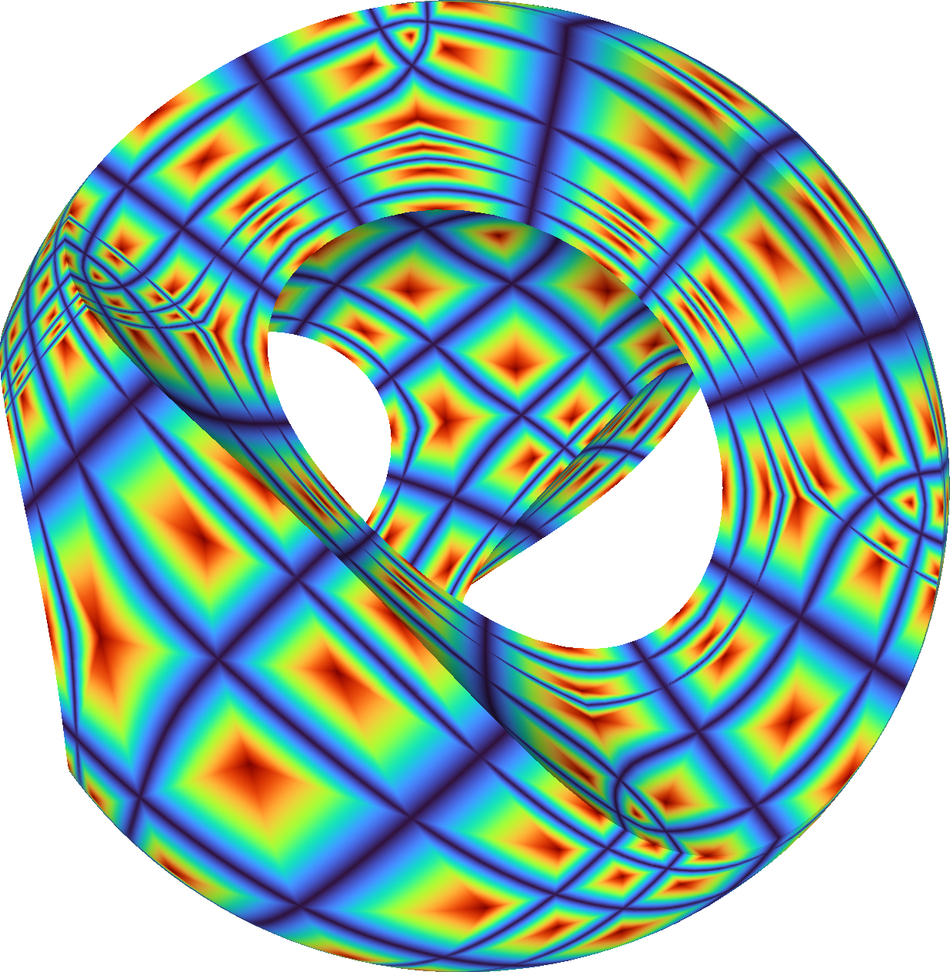
Examples: CDF & DCDF
Chart Distance Fields
Dual Chart Distance Fields
Notes:
Here are a few CDF and DCDF examples on real quad meshes.

Slide 9
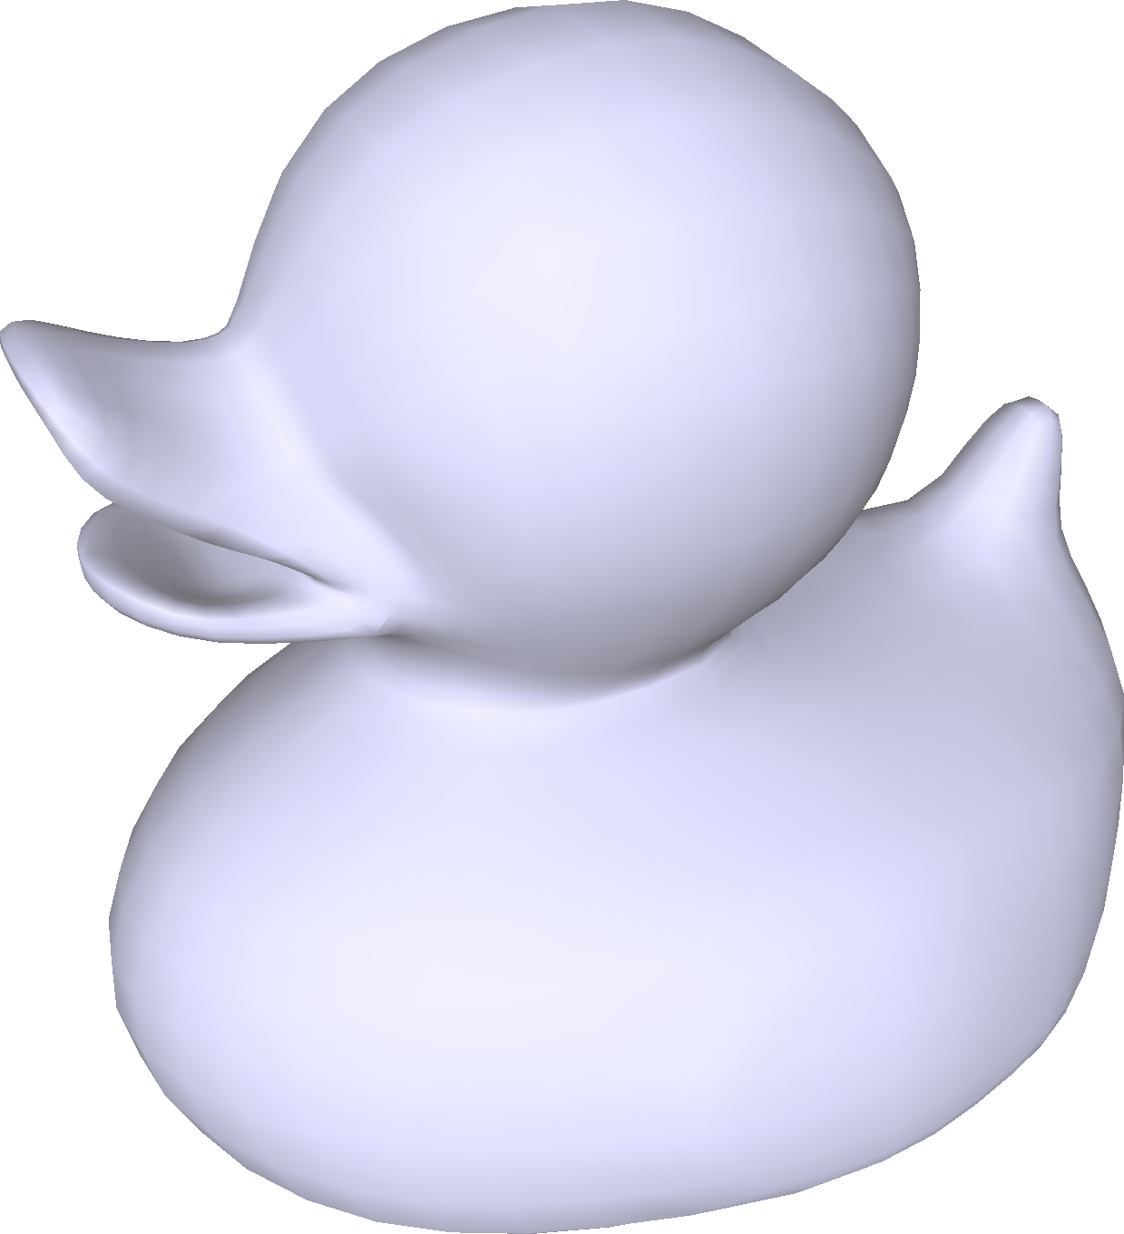
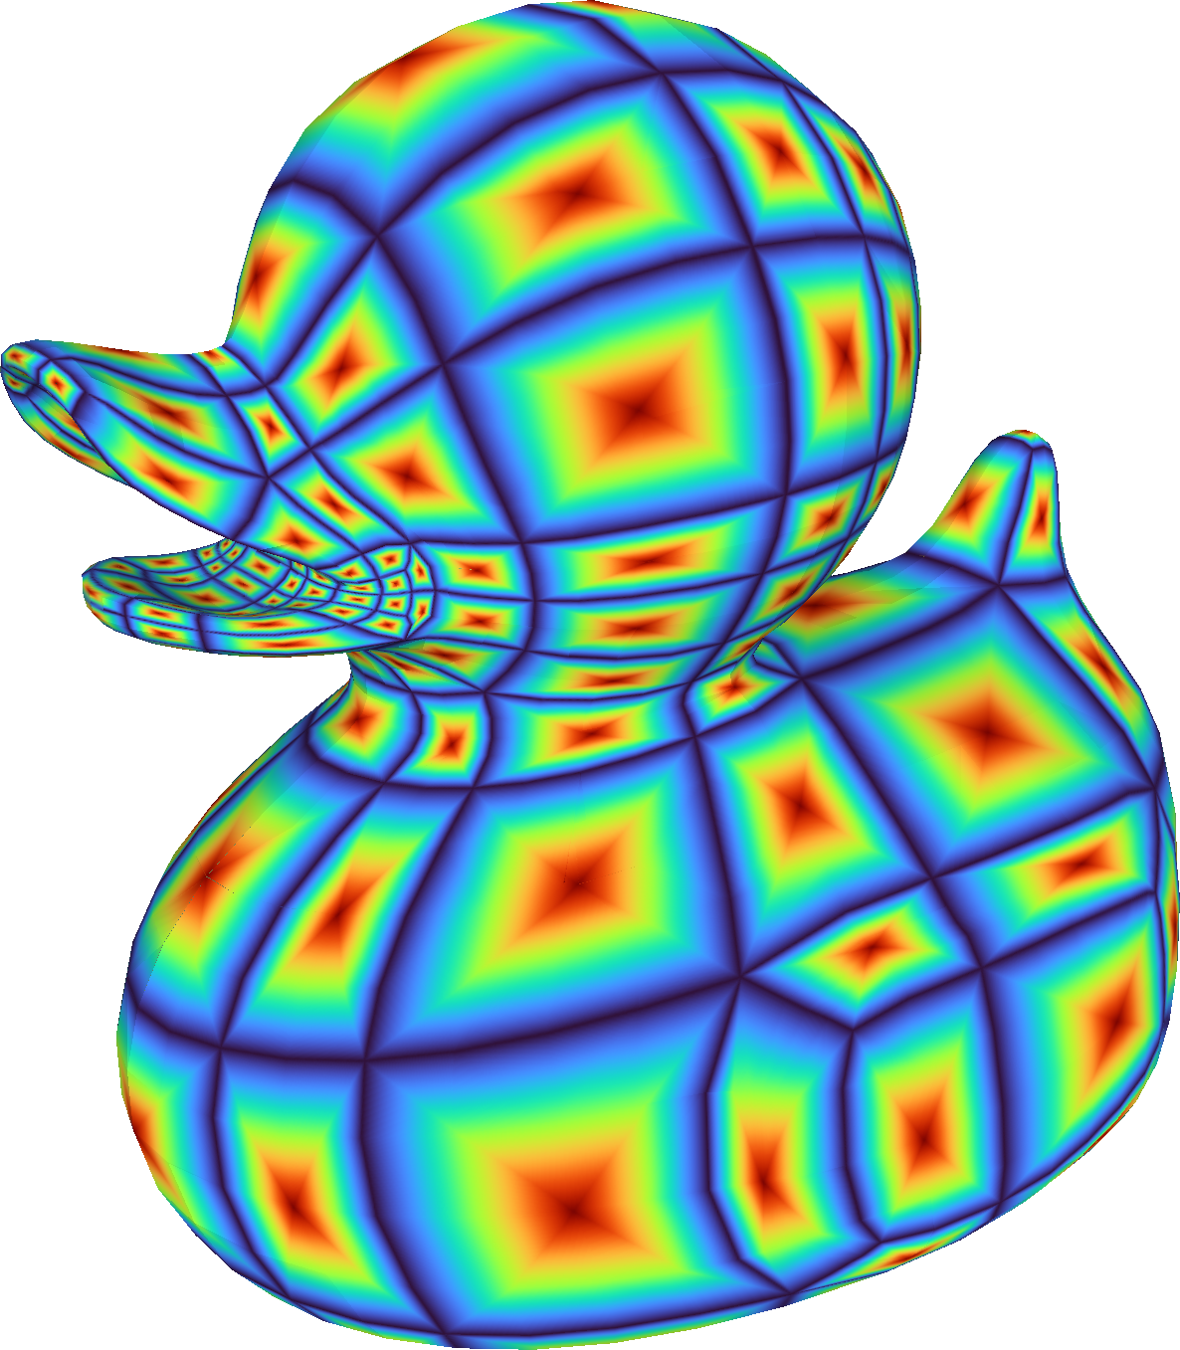
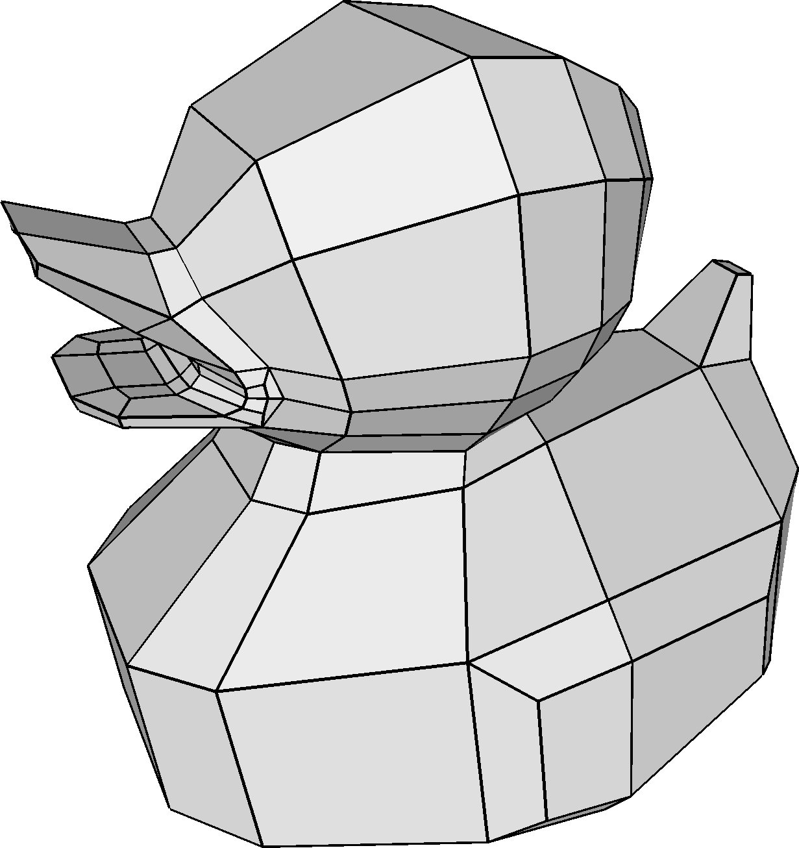

SQuadGen: Learn and Synthesize CDFs via Latent Diffusion Models
Encode geometry as conditions
Diffusion model for CDF latent synthesis
Geom-AE
SQ-Diffuse
time stamp: $t$
Geo-Encoder
Geo-Decoder
Add
SIT Model
conditioning
noisy SQ latent
denoised SQ latent
SQ-VAE
conditioning
Inference Stage
VecSet variance
SQ-Encoder
SQ-Decoder
Layout Extraction
SQ-
Decoder
VecSet mean
Encode layouts into latent space
Extract quad layouts and mesh refinement
Notes:
Building on this representation, we design a generative framework to synthesize CDF for a given shape, using four modules.
[click] Geom-AE encodes the 3D geometry as conditions.
[click] SQ-VAE encodes the CDF into its latent space.
[click] Then, A geometry-conditioned diffusion model generates the CDF latents.
[click] At inference, we extract the quad layout from the generated CDF.

Slide 10
Training Data Curation
Data Creation
Large data source: Objaverse
  created by artists; original quad-dominant layouts are missing
Loop-aware triangle merging algorithm
  Recover all-quad meshes
Recovered quad layouts
  1.6 million single-connected quad meshes
Curated simple quad layouts: 230k
  filtering via loop simplicity scores (>0.618) and other criteria
Samples of curated data
Notes:
A learning method needs data, but the large data source such as Objaverse doesn’t have the original quad layouts, they are stored as triangles.
So we build a loop-aware triangle merging algorithm, to recover all-quad meshes.
We recovered the quad meshes, and filering them by our loop simplicity and other criteria.
Finally, we obtain about two thirty thousand layouts for training.

Slide 11
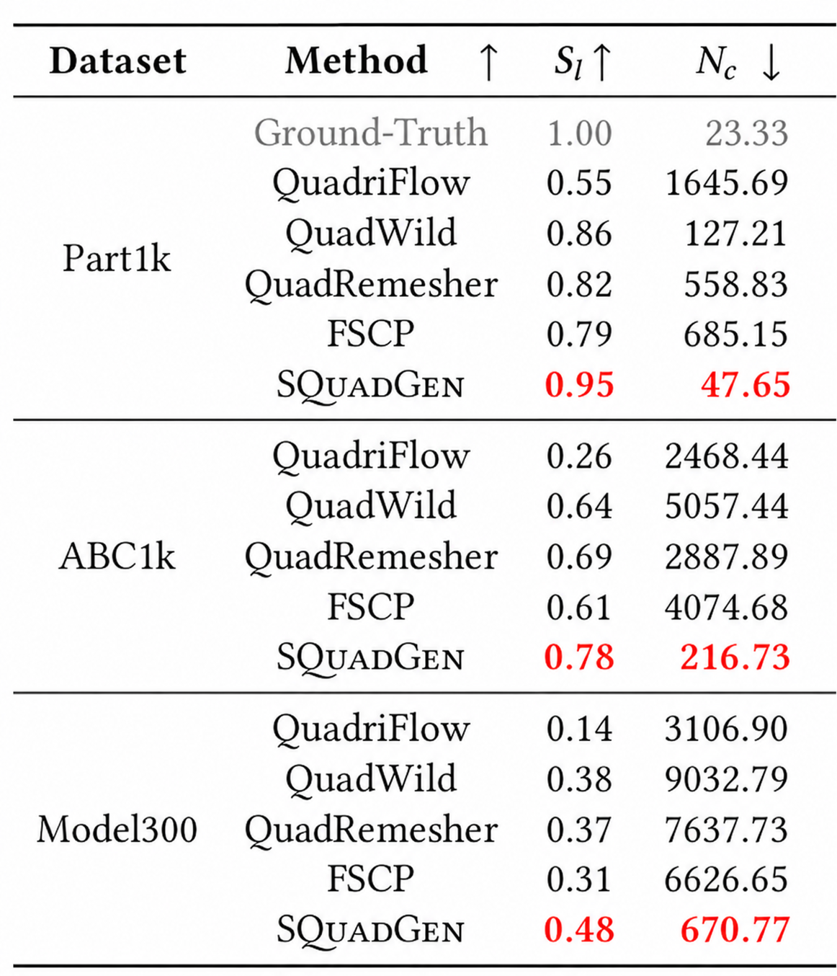
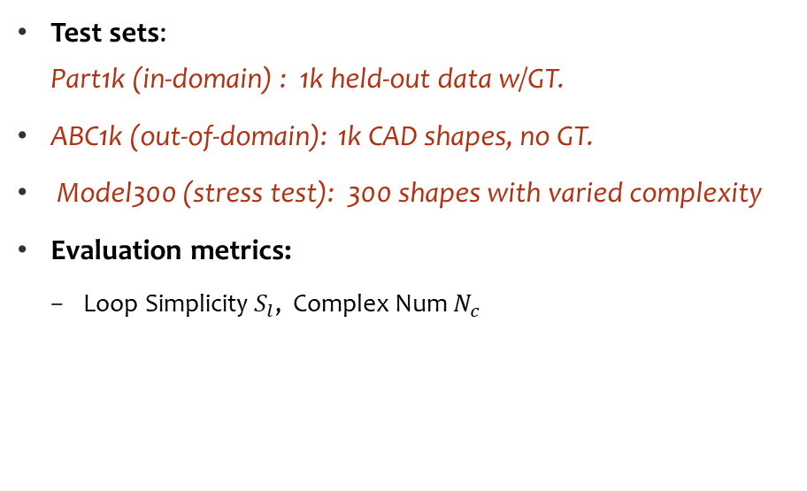
Experimental Setup & Performance
Evaluation Setup
Test sets:
Part1k (in-domain) : 1k held-out data w/GT.
ABC1k (out-of-domain): 1k CAD shapes, no GT.
Model300 (stress test): 300 shapes with varied complexity
Evaluation metrics:
  Loop Simplicity $S_{l}$, Complex Num $N_{c}$
Highest simplicity score
~10x fewer quad charts.
Notes:
We evaluate our method on three test datasets: an in-domain dataset part1k, an out of domain CAD dataset abc1k, and a hard and detailed set model300 as stress test.
[click] Across all benchmarks, our method reaches a highest simplicity score with about 10 fewer quad charts.

Slide 12

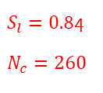

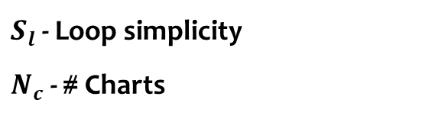
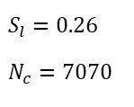

Visual Comparison (cont.)
$S_{l}$- Loop simplicity
$N_{c}$- # Charts
Random color per chart — fewer & larger ~ simpler
QuadWild
QuadriFlow
$$S_{l}=0.26$$
$$N_{c}=7070$$
$S_{l}=0.$03
$$N_{c}=3910$$
Ours
Synthesized CDF
$S_{l}=0.$84
$$N_{c}=260$$
Input
QuadRemesher
FSCP
$S_{l}=0.$15
$$N_{c}=4328$$
$S_{l}=0.2$4
$N_{c}=$3454
Ours produces the simplest layouts
with far fewer charts.
Notes:
Here are visual comparisons, where each chart is drawn in a random color.
Our method produces the simplest layouts, with far fewer charts.

Slide 13
Visual Comparison
Random color per chart — fewer & larger ~ simpler
Input
QuadWild
QuadriFlow
QuadRemesher
FSCP
Ours
Synthesized CDF
Notes:
Here are more visual comparisons.

Slide 14
Visual Comparison (cont.)
Random color per chart — fewer & larger ~ simpler
Input
QuadWild
QuadriFlow
QuadRemesher
FSCP
Ours
Synthesized CDF

Slide 15
Comparison with Learning-based Low-Poly & Quad Meshing Approaches
HunYuan3D: Triangle & more irregularities
Tripo3D & NeurCross: many spiral loops & charts,
sharp features missing
Ours: simple layout & feature preserving
HunYuan3D
Tripo3D
NeurCross
Ours
commercial product
commercial product
Siggraph 2025
Notes:
We also compare against recent learning-based methods, two of them are commercial products.
Even on these simple shapes, they fail to produce simple layouts and often lose the sharp features.
our method stays simple and feature-preserving.

Slide 16
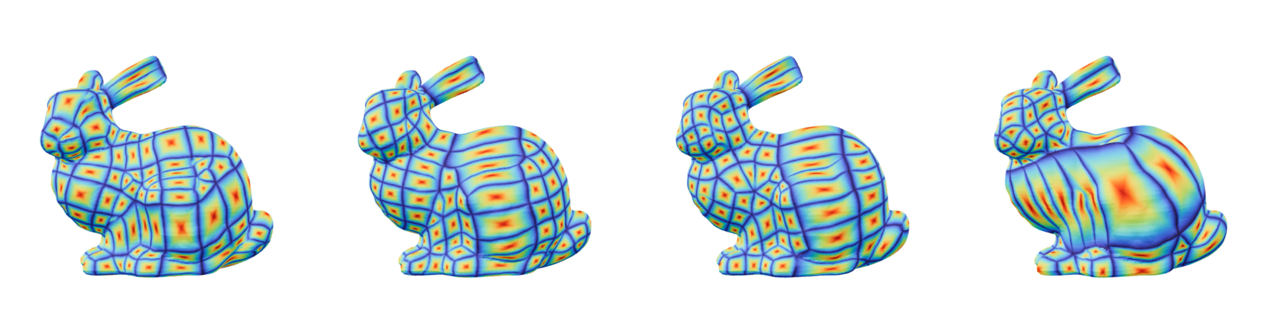
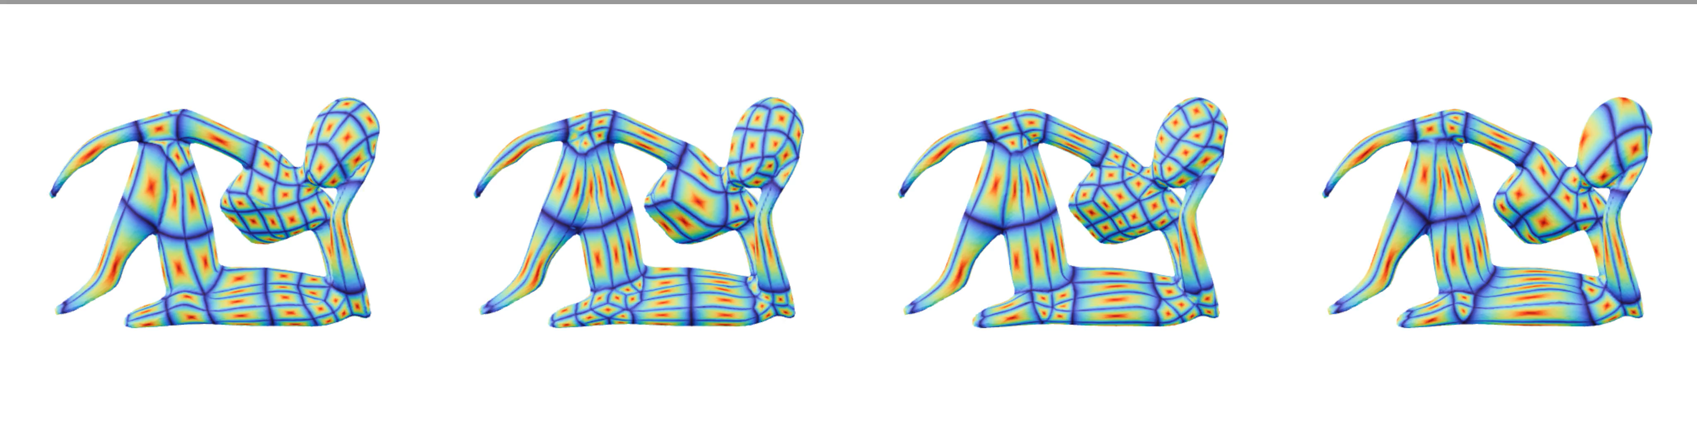
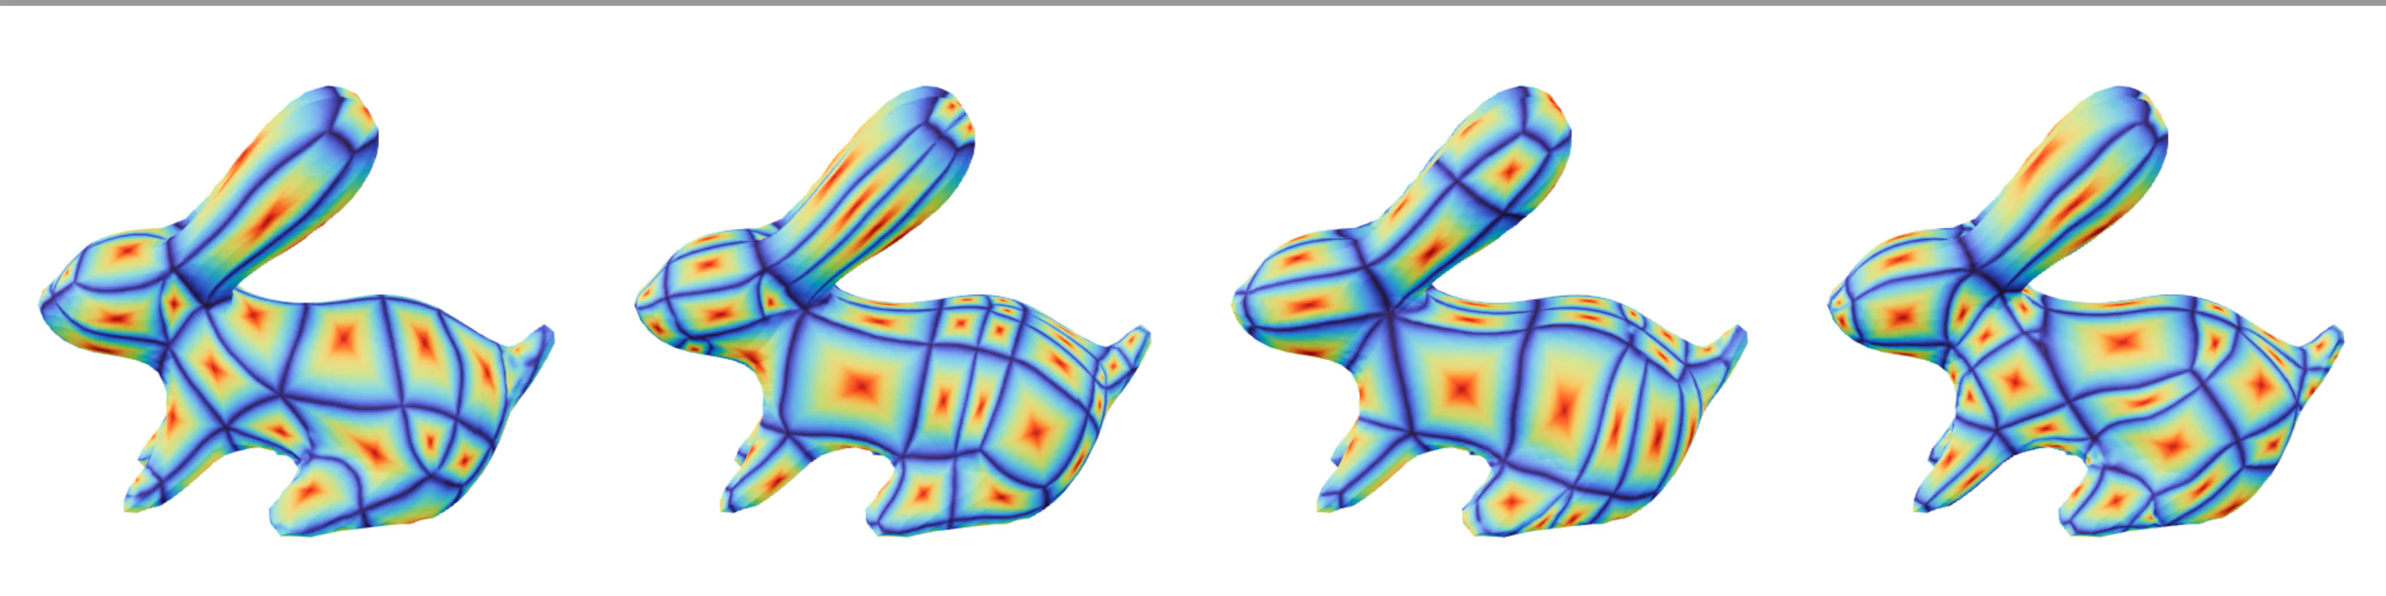
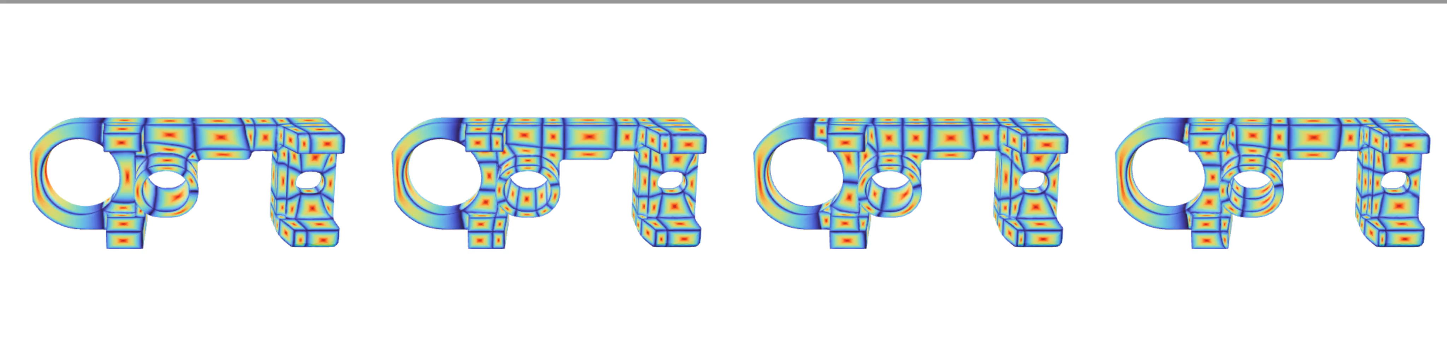
Diverse Generated Results
Notes:
Our method can produce diverse and reasonable results on same geometry, thanks to the generation model.
So in practice you can sample several layouts and select the best one.

Slide 17
Generalizability and Failure Cases
Generalizability
Failure examples
Generalizes well on out-of-distribution but smooth shapes
Fail on shapes with fine details (unseen in training) → invalid CDFs
Notes:
Our method also generalizes well to out-of-distribution but smooth inputs, such as the elephant and dragon models.
But it fails on shapes with very fine detail, which are unseen in training, where it produces invalid CDF.

Slide 18

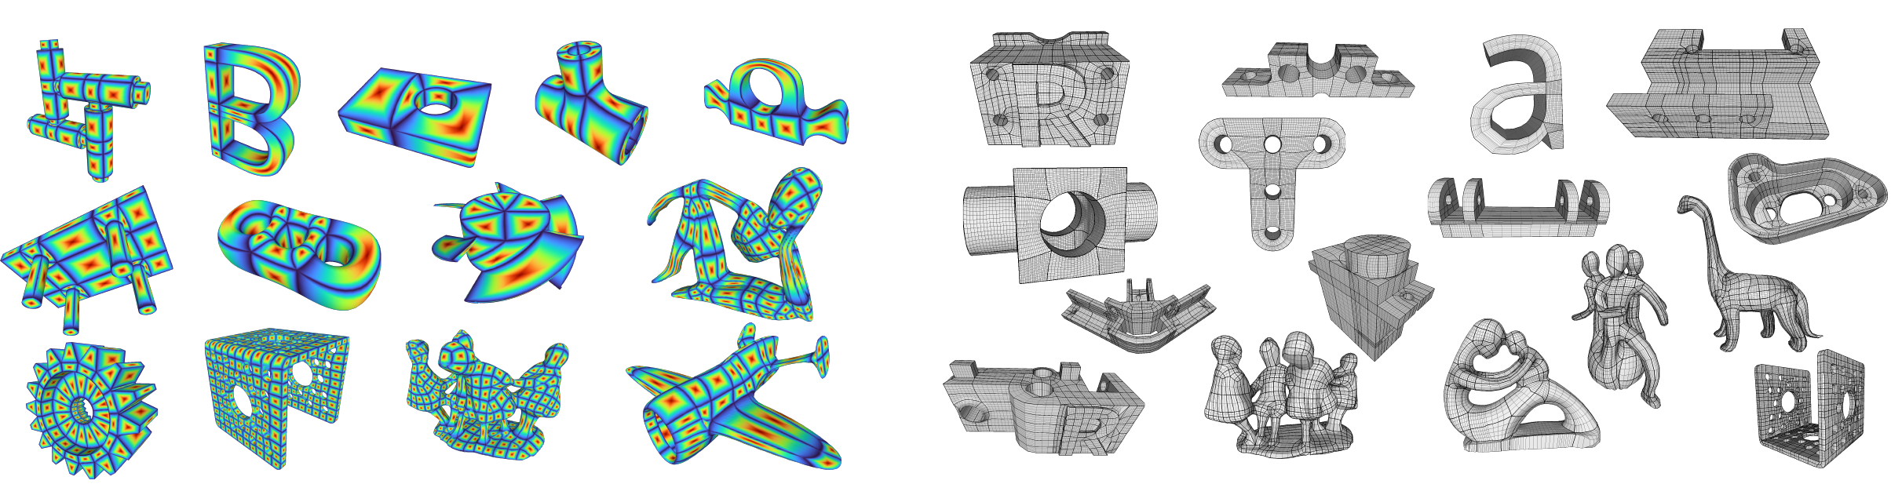
Take-Home Message
Goal: generate a clean and simple layout for editing.
Representation: Chart Distance Field — easy-to-learn continuous fields for quad layout generation
Loop Simplicity: Loop-editing-aware metric
Dataset — 230k simple quad layouts: diverse, large-scale, high loop simplicity scores.
SQuadGen: Diffusion model to generate CDFs and yield simple and editable quad layouts.
Code & Model: To be released, currently undergoing the release approval process.
Project page
Notes:
To wrap up: we started from one belief — for editing, what matters is a clean, simple layout.
We turn that layout into a smooth field, the CDF, and let a diffusion model generate it. Trained on our large dataset, this yields simpler, more editable layouts than both state-of-the-art research methods and commercial tools.
Thank you.

